Slide 1
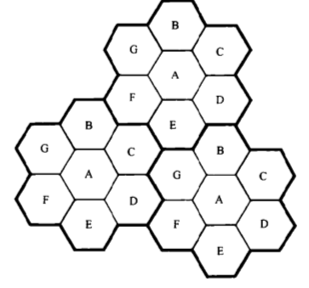
Co-Channel Interference and System Capacity
The interference between signals from Co channel cells is called Co-channel Interference.
To reduce co-channel interference, co-channel cells must be physically separated by a minimum distance to provide sufficient isolation.
Adjacent Channels
4
5
3
1
6
2
7
Co- Channels
Courtesy to Theodore S. Rappaport
©2002, 1996 Prentice Hall PTR

Slide 2
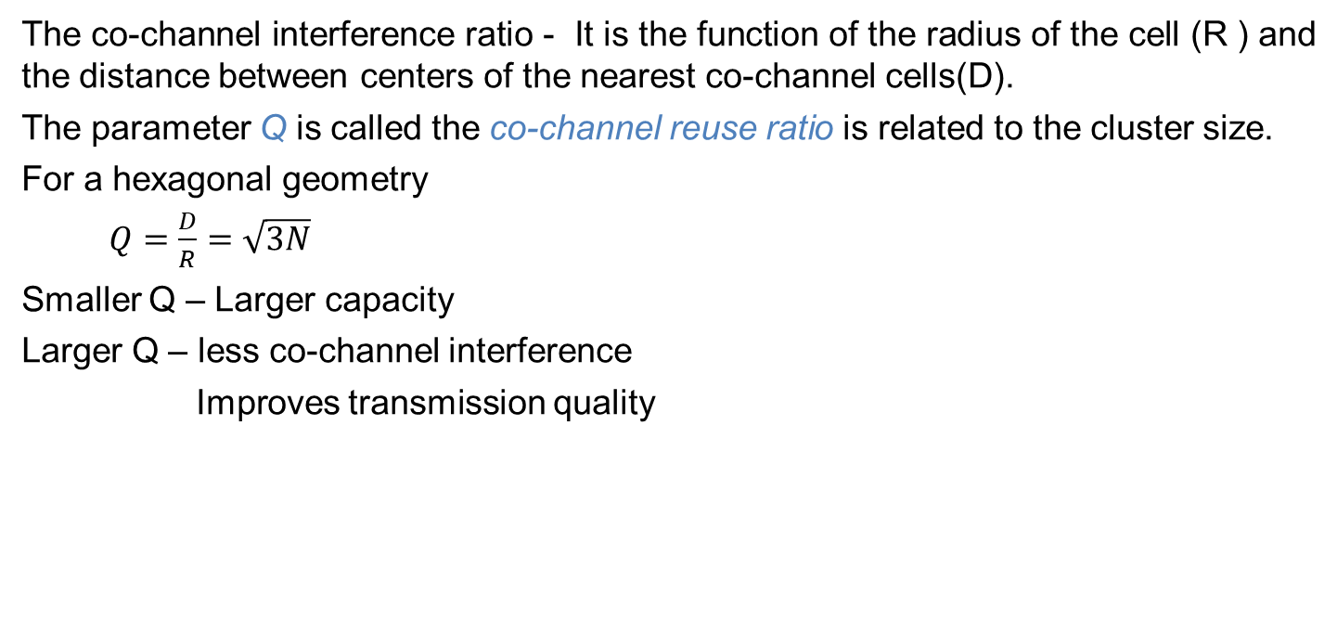
Co-Channel Interference and System Capacity
The co-channel interference ratio - It is the function of the radius of the cell (R ) and the distance between centers of the nearest co-channel cells(D).
The parameter Q is called the co-channel reuse ratio is related to the cluster size.
For a hexagonal geometry
$Q=\frac{D}{R}=\sqrt{3N}$
Smaller Q – Larger capacity
Larger Q – less co-channel interference
Improves transmission quality

Slide 3
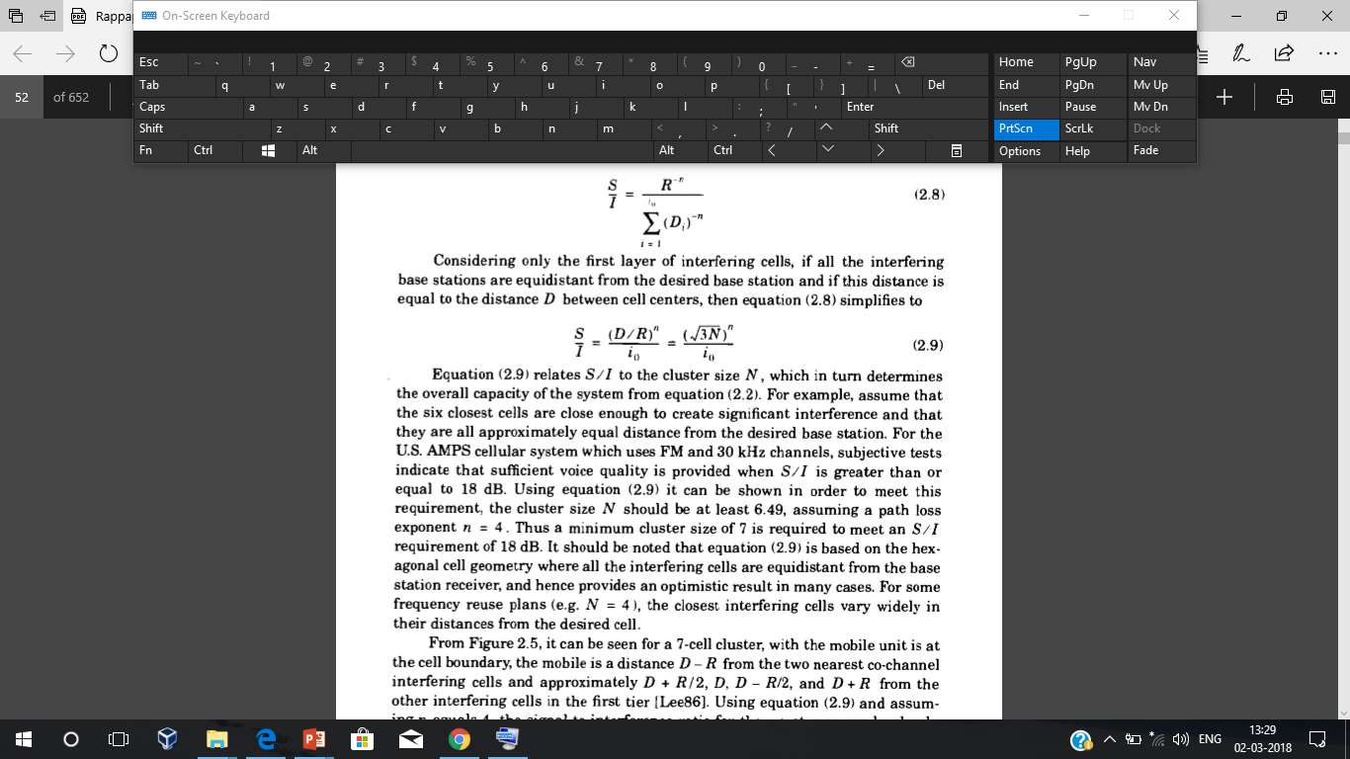
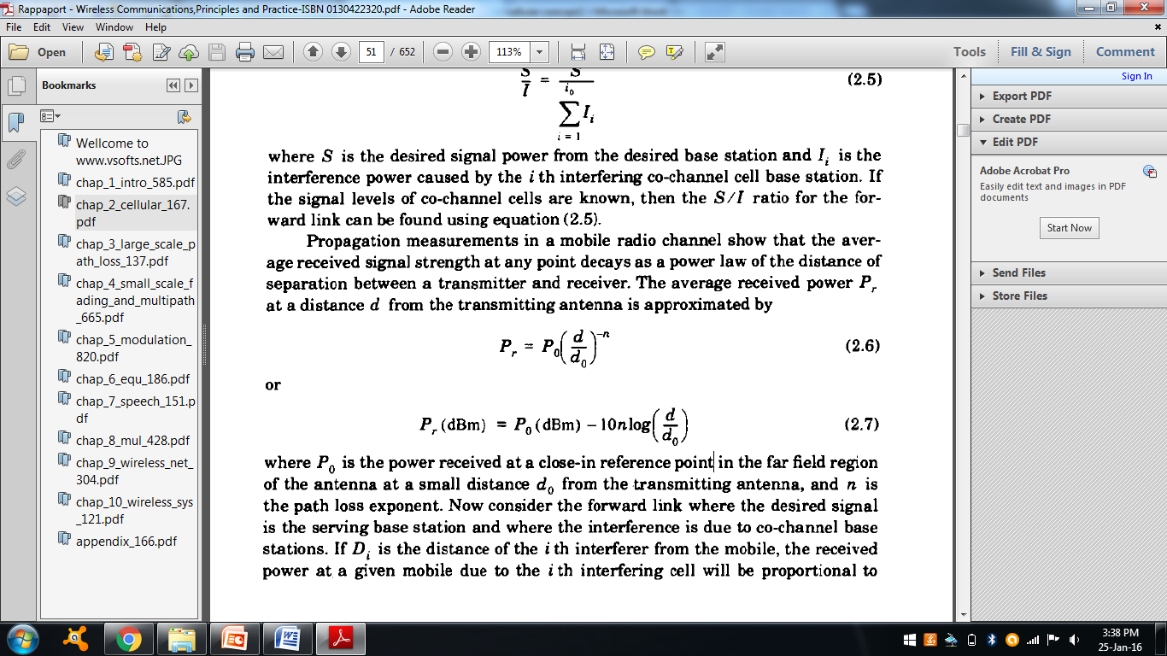
Co-Channel Interference and System Capacity
i0 - number of co-channel interfering cells
The average power received at a distance d from the transmitting antenna is
Power received at a reference point in the far field region of an antenna at a distance d0

Slide 4
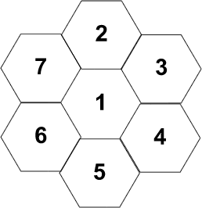
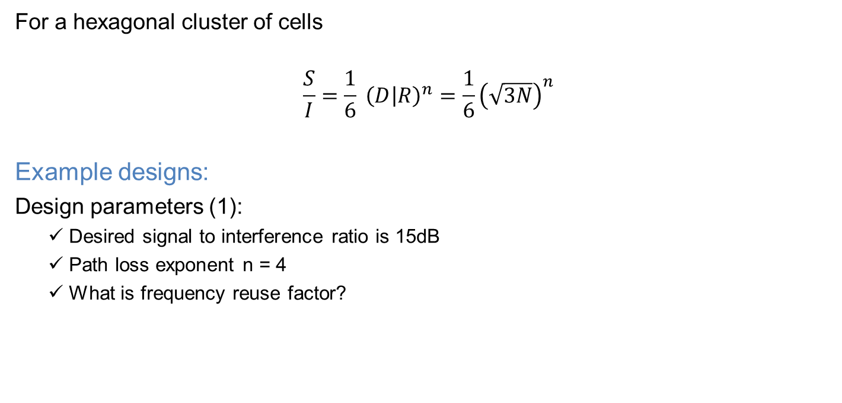
Calculation of SIR
For a hexagonal cluster of cells
$$\frac{S}{I}=\frac{1}{6} {\left(D | R\right)}^{n}=\frac{1}{6}{\left(\sqrt{3N}\right)}^{n}$$
Example designs:
Design parameters (1):
Desired signal to interference ratio is 15dB
Path loss exponent n = 4
What is frequency reuse factor?

Slide 5
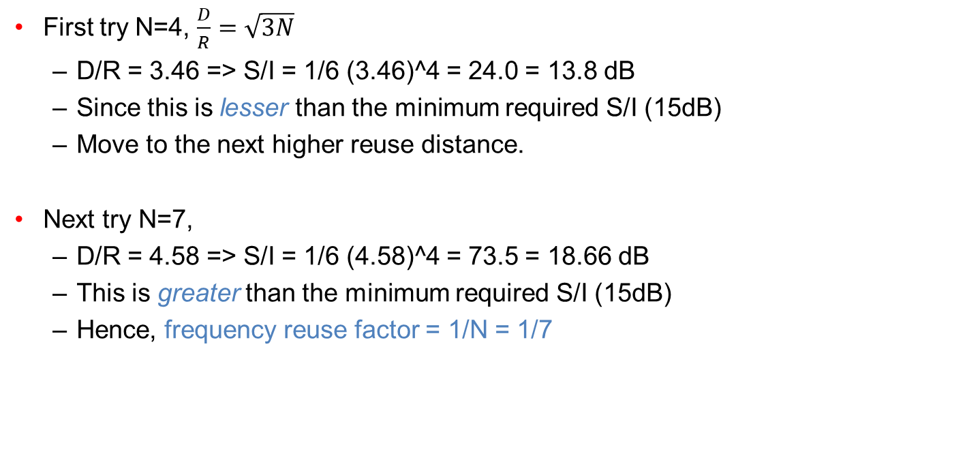
Calculation of SIR
First try N=4, $\frac{D}{R}=\sqrt{3N}$
D/R = 3.46 => S/I = 1/6 (3.46)^4 = 24.0 = 13.8 dB
Since this is lesser than the minimum required S/I (15dB)
Move to the next higher reuse distance.
Next try N=7,
D/R = 4.58 => S/I = 1/6 (4.58)^4 = 73.5 = 18.66 dB
This is greater than the minimum required S/I (15dB)
Hence, frequency reuse factor = 1/N = 1/7

Slide 6
Adjacent Channel interference (ACI)
ACI results from signals that are adjacent in the frequency to the desired signal.
This results from imperfect receiver filters that allow nearby frequencies to leak in.

Slide 7
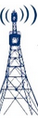
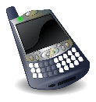
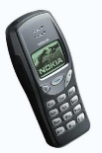
Adjacent Channel interference (ACI)
Near far effect: An interferer close to the BS radiates in the adjacent channel while the subscriber is far away from the BS.
To overcome ACI, the frequency separation between each channel in cell should be made as large as possible.
Block entire cell
Overpowered by strong signals
Interferer
To overcome ACI, the frequency separation between each channel in cell should be made as large as possible.
BS
Subscriber

Slide 8
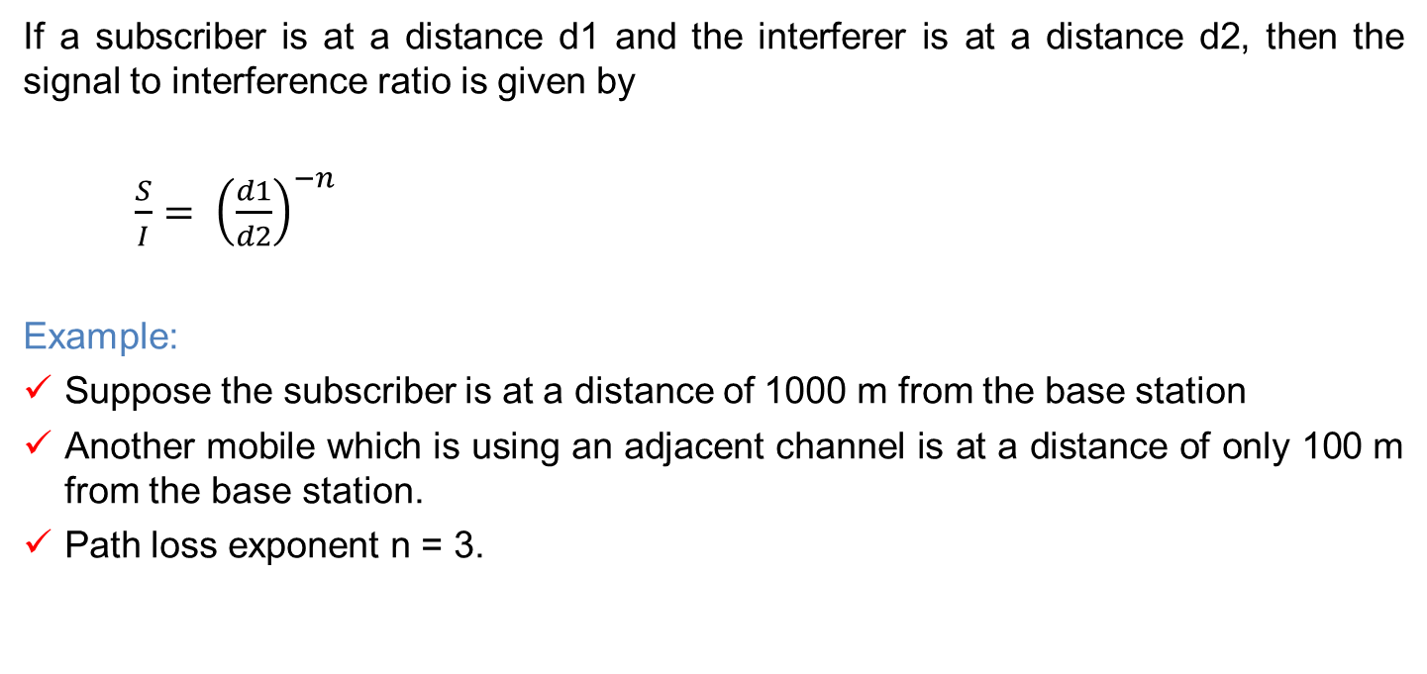
Adjacent Channel interference (ACI)
If a subscriber is at a distance d1 and the interferer is at a distance d2, then the signal to interference ratio is given by
$\frac{S}{I}= {\left(\frac{d1}{d2}\right)}^{−n}$
Example:
Suppose the subscriber is at a distance of 1000 m from the base station
Another mobile which is using an adjacent channel is at a distance of only 100 m from the base station.
Path loss exponent n = 3.

Slide 9
Power control
Reduction of interference is possible by having the power level transmitted by user are under constant control by the serving base station.
Power control improves long life of battery for the user
Reduces the reverse channel S/I in the system.

Slide 10
Summary
co-channel cells must be physically separated by a minimum distance to provide sufficient isolation and avoid co-channel interference.
Imperfect receiver filters and also the near far effect are the cause for the adjacent channel interference.
Power control improves battery life and also help in reducing the reverse channel S/I ratio.

